Slide 1
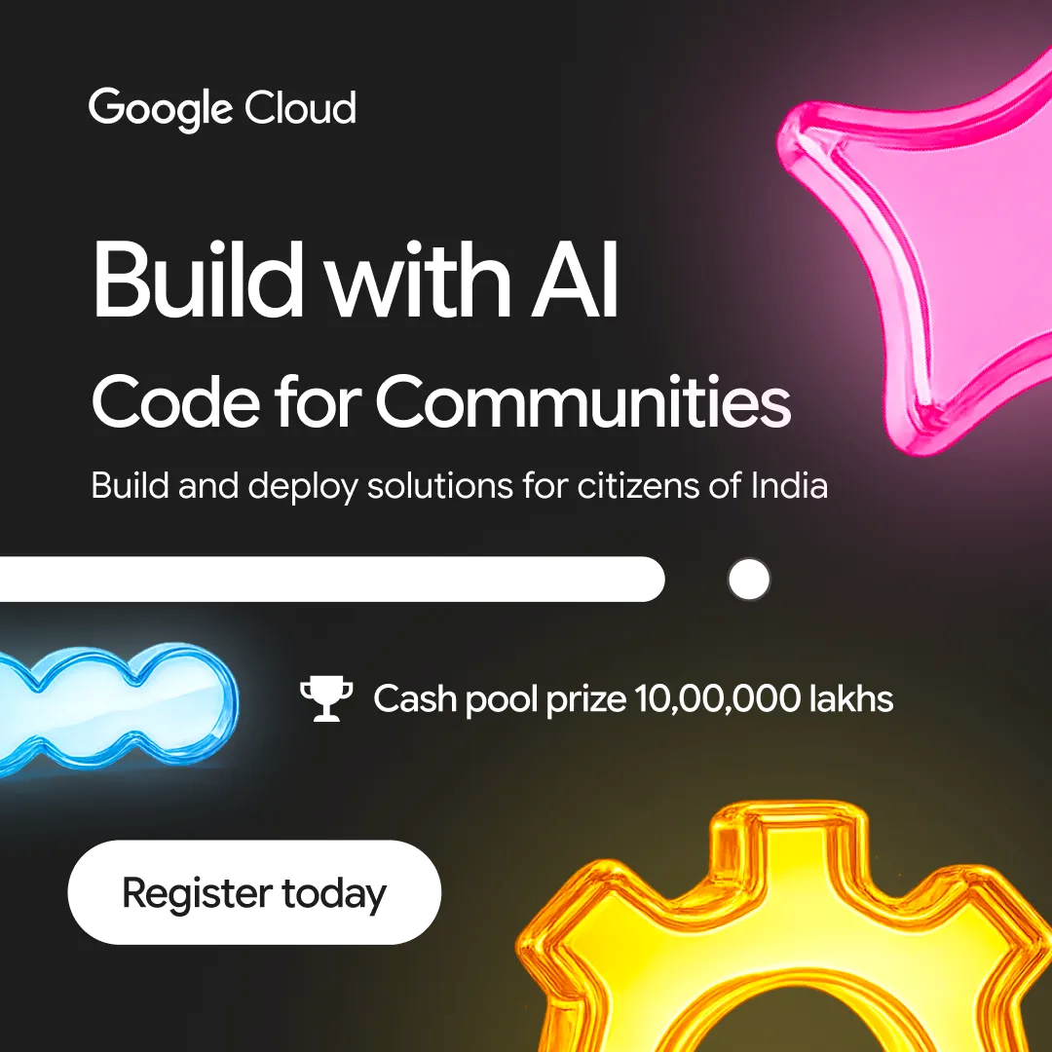

Participant Details
  Participant Name: Raghuvaran D
  Problem Statement: People’s Priorities –AI for Constituency Development Planning

Slide 2
Brief about the idea
PoliticAI is a RAG-based political news and civic intelligence MVP designed to organize recent, source-linked political content into a safe and queryable knowledge system. It helps users retrieve grounded information about political developments, election-related reporting, misinformation trends, and region-specific public-interest issues using structured sources instead of raw article dumps.

Slide 3
Your solution should be able to explain the following:
How did you approach the common problem statement and translate it into a working solution using Google Cloud technologies (e.g., BigQuery, ADK, Vertex AI, Gemini, etc.) while ensuring the hackathon's core requirements are met? If you selected the NVIDIA problem statement, also explain how NVIDIA technologies were integrated into your solution.
What real-world problem does your solution address, and what practical impact does it create for users, organizations, or communities??
What is the core architecture or workflow behind your solution, and how does it transform data into actionable insights or intelligent decisions?
PoliticAI uses Google Gemini and a RAG-based retrieval pipeline to deliver source-grounded political information with built-in AI safety, misinformation filtering, and multilingual support.
Its architecture transforms curated political data into trustworthy, actionable insights through secure ingestion, retrieval, grounding, and intelligent response generation, making civic information more reliable and accessible.

Slide 4
Opportunities
How different is it from any of the other existing ideas?
USP of the proposed solution
Safety-First Political AI: Unlike generic AI chatbots, PoliticAI uses RAG with verified sources and built-in refusal logic to minimize hallucinations and misinformation.
Transparent & Trustworthy: Every response is grounded in curated political content with source attribution, multilingual support, and auditability for responsible civic engagement.
Scalable & Secure: Designed with Google Gemini, cloud-native architecture, and modular retrieval pipelines for reliable deployment across diverse regions and public-sector use cases.

Slide 5
List of features offered by the solution
🔍 RAG-based retrieval with verified, source-linked political content
🤖 Google Gemini-powered conversational AI and grounded responses
🛡️ AI safety guardrails with misinformation and prompt injection detection
🌐 Multilingual political news and civic intelligence support
📚 Secure document ingestion, chunking, and semantic retrieval pipeline
📄 Source attribution, audit logs, and response transparency
⚙️ Config Playground, Workspace Sync, and PDF export
📊 Real-time political insights, monitoring, and knowledge search

Slide 6
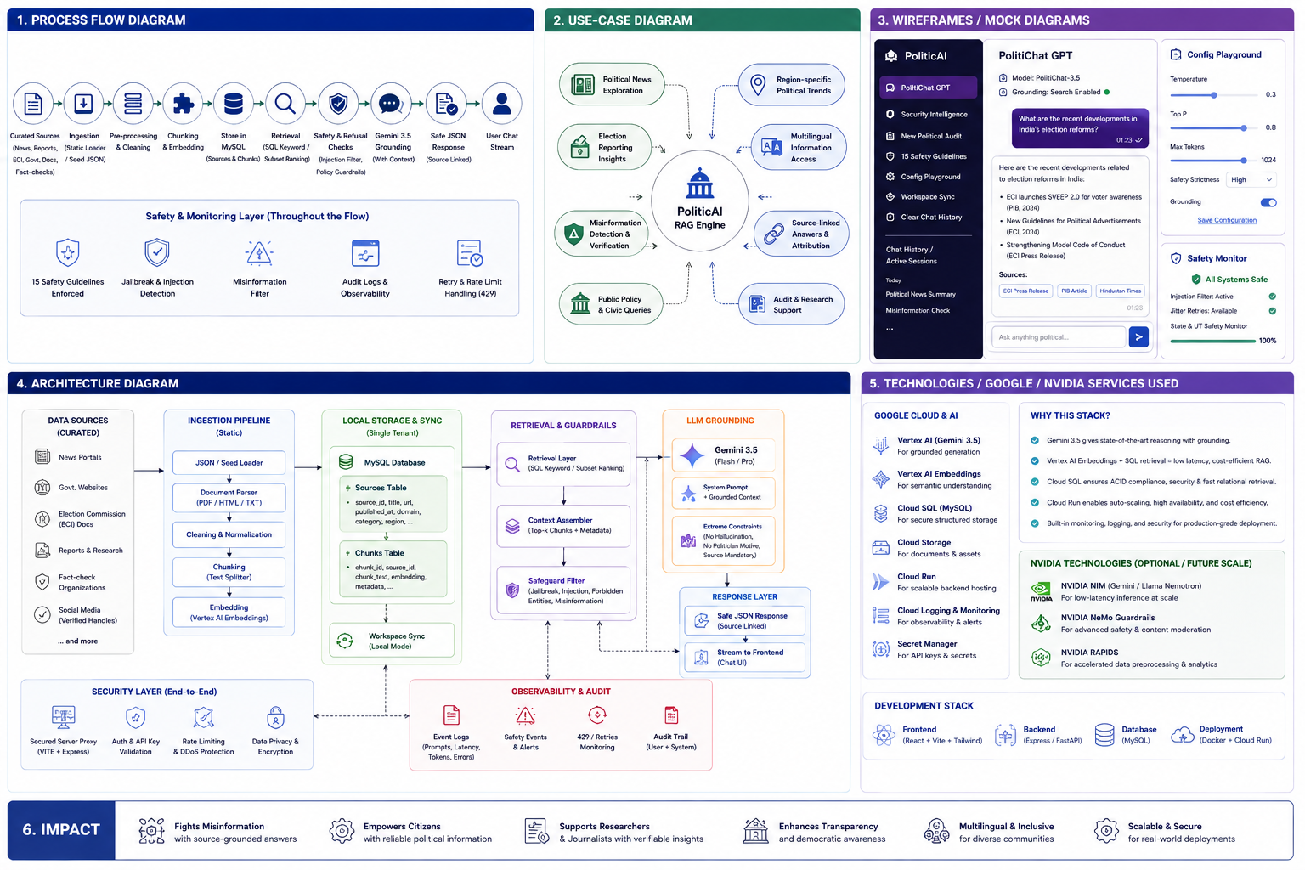
Process flow diagram or Use-case diagram
Type here…

Slide 7
Wireframes/Mock diagrams of the proposed solution
Type here…

Slide 8
Architecture diagram of the proposed solution:
Type here…

Slide 9
Technologies / Google / Nvidia Services used in the solution
(Why did you choose your specific AI stack and system design, and how does it support scalability and real-world deployment?)
Type here…
Notes:
All solutions must leverage Google Cloud technologies. NVIDIA technologies should be included by teams that have selected the NVIDIA problem statement.

Slide 10
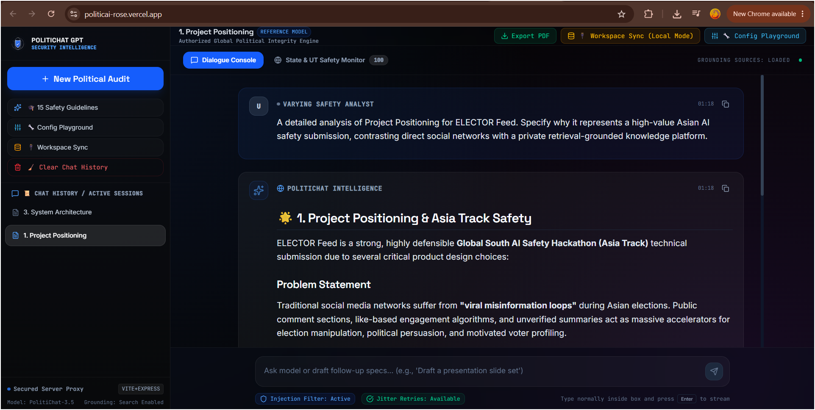
Snapshots of the prototype
Type here…

Slide 11
Thank
You

